Slide 1
CSS
MCNDHS
Ms. Eng

Slide 2
aim: SELECtors – child selector
Do now:
Daily Grade:
On-time/attendance/not leaving the classroom: 25%
Cellphones: 25%
Notes:25%
Classwork/Homework: 25%

Slide 3
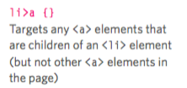
child selector

Slide 4

descendant

Slide 5
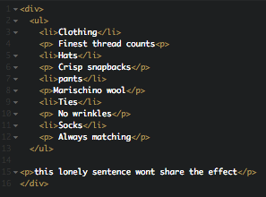
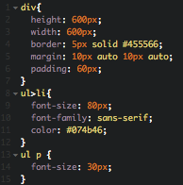
example:

